Slide 1
https://lars.vilhuber.com/s (and choose UW Madison 2019) .

Slide 2
Replication and Reproducibility in Social Sciences and Statistics: Context, Concerns, and Concrete Measures
Lars Vilhuber
Cornell University
Partial funding acknowledged under NSF-#1131848 (NCRN) and a grant from the Alfred P. Sloan Foundation. The opinions expressed in this talk are solely the authors, and do not represent the views of the U.S. Census Bureau, the American Economic Association, or any of the funding agencies.
Notes:
I am going to
Very briefly describe the background we are coming from
Make note of the various elements of progress (and the broader picture) of open science
Describe some of the ongoing challenges
Provide a glimpse of what is going to happen in economics, and maybe more broadly in the social sciences.

Slide 3
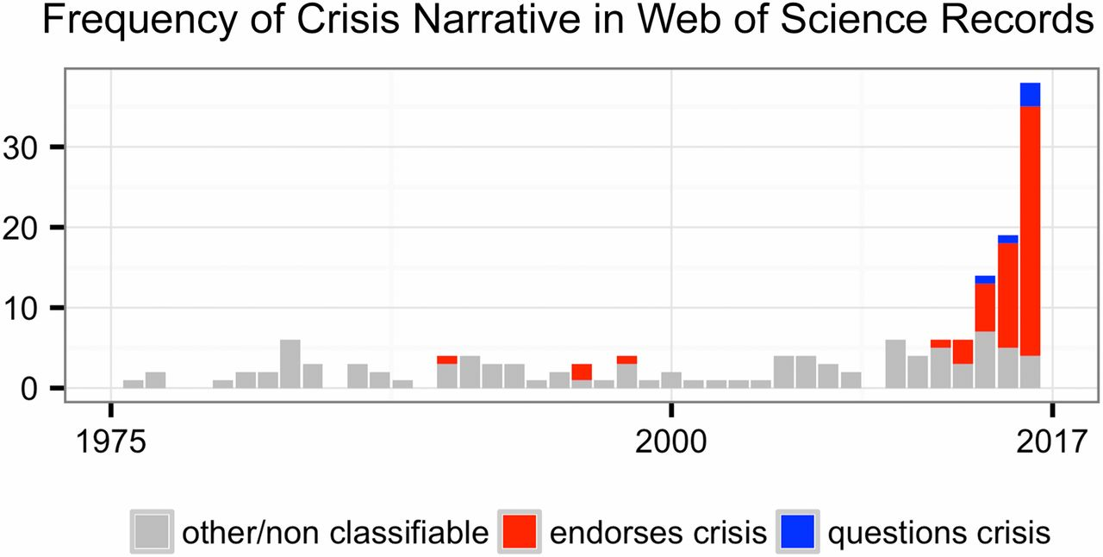
This reproducibility crisis thing….
https://doi.org/10.1073/pnas.1708272114
Notes:
Number of Web of Science records that in the title, abstract, or keywords contain one of the following phrases: “reproducibility crisis,” “scientific crisis,” “science in crisis,” “crisis in science,” “replication crisis,” “replicability crisis.” Records were classified by the author according to whether, based on title and abstracts, they implicitly or explicitly endorsed the crisis narrative described in the text (red), or alternatively questioned the existence of such a crisis (blue), or discussed “scientific crises” of other kinds or could not be classified due to insufficient information (gray).

Slide 4
The “crisis” in the 60s and 70s Sterling, 1959; Cohen, 1962; Lykken, 1968; Tukey, 1969; Greenwald, 1975; Meehl, 1978; Rosenthal, 1979
Low power
Flexibility in analysis
Selective reporting
Ignoring nulls
Lack of replication
Misuse of statistics
Source: Nosek Sackler talk 2017
Notes:
Source: Nosek, NAS.Sackler.2017.03.10
Examples from:
Button et al – Neuroscience
Ioannidis – why most results are false (Medicine)
GWAS
Biology
Two possibilities are that the percentage of positive results is inflated because negative results are much less likely to be published, and that we are pursuing our analysis freedoms to produce positive results that are not really there. These would lead to an inflation of false-positive results in the published literature.
Some evidence from bio-medical research suggests that this is occurring. Two different industrial laboratories attempted to replicate 40 or 50 basic science studies that showed positive evidence for markers for new cancer treatments or other issues in medicine. They did not select at random. Instead, they picked studies considered landmark findings. The success rates for replication were about 25% in one study and about 10% in the other. Further, some of the findings they could not replicate had spurred large literatures of hundreds of articles following up on the finding and its implications, but never having tested whether the evidence for the original finding was solid. This is a massive waste of resources.
Across the sciences, evidence like this has spurred lots of discussion and proposed actions to improve research efficiency and avoid the massive waste of resources linked to erroneous results getting in and staying in the literature, and about the culture of scientific practices that is rewarding publishing, perhaps at the expense of knowledge building. There have been a variety of suggestions for what to do. For example, the Nature article on the right suggests that publishing standards should be increased for basic science research.
[It is not in my interest to replicate – myself or others – to evaluate validity and improve precision in effect estimates (redundant). Replication is worth next to zero (Makel data on published replications; motivated to not call it replication; novelty is supreme – zero “error checking”; not in my interest to check my work, and not in your interest to check my work (let’s just each do our own thing and get rewarded for that)
Irreproducible results will get in and stay in the literature (examples from bio-med). Prinz and Begley articles (make sure to summarize accurately)
The Nature article by folks in bio-medicine is great. The solution they offer is a popular one in commentators from the other sciences -- raise publishing standards.

Slide 5
Efficiency of scholary discourse?
Early publications (20th century) contained tables of data, and the math was simple (maybe)
Data became electronic, was no longer included or cited
Math was transcribed to code, and was no longer included

Slide 6
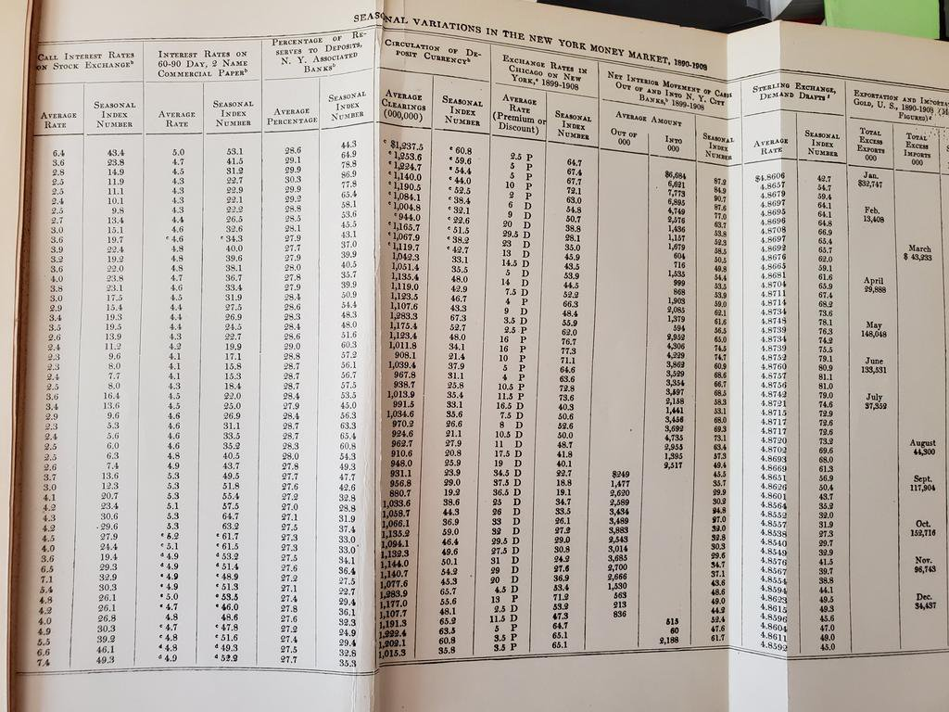
From @sdellavi
AER 1911

Slide 7
Efficiency of scholary discourse!
Modern publications thus need the same transparency and completeness as in the old days
to facilitate replicability

Slide 8
Replication?

Slide 9

Replication continuum
https://doi.org/10.17226/25303
08
Reproducibility
Narrow Replication (Pesaran 2003)
Pure Replication (Hamermesh 2007)
Verification (Clemens 2015)

Slide 10
Replication continuum
Same data | Same code | Same methods | Same context
08
Reproducibility
Narrow Replication (Pesaran 2003)
Pure Replication (Hamermesh 2007)
Verification (Clemens 2015)

Slide 11
Replication continuum
08
08
Reproducibility
Replicability
Narrow Replication (Pesaran 2003)
Pure Replication (Hamermesh 2007)
Verification (Clemens 2015)
Wide Replication (Pesaran 2003)
Statistical Replication (Hamermesh 2007)
Reproduction/Reanalysis (Clemens 2015)

Slide 12
Replication continuum
Same data | Different code | Same methods | Same context
 | or software
08
08
Reproducibility
Replicability
Narrow Replication (Pesaran 2003)
Pure Replication (Hamermesh 2007)
Verification (Clemens 2015)
Wide Replication (Pesaran 2003)
Statistical Replication (Hamermesh 2007)
Reproduction/Reanalysis (Clemens 2015)

Slide 13
Replication continuum
New data | Same code | Same methods | Same context
collection
08
08
Reproducibility
Replicability
Narrow Replication (Pesaran 2003)
Pure Replication (Hamermesh 2007)
Verification (Clemens 2015)
Wide Replication (Pesaran 2003)
Statistical Replication (Hamermesh 2007)
Reproduction/Reanalysis (Clemens 2015)

Slide 14
Replication continuum
08
08
08
Reproducibility
Replicability
Generalizability
Narrow Replication (Pesaran 2003)
Pure Replication (Hamermesh 2007)
Verification (Clemens 2015)
Wide Replication (Pesaran 2003)
Statistical Replication (Hamermesh 2007)
Reproduction/Reanalysis (Clemens 2015)
Wider Replication (Pesaran 2003)
Scientific Replication (Hamermesh 2007)
Reanalysis/Robustness (Clemens 2015)

Slide 15
Replication continuum
Different data | Different code | Different | Different
 | or software | methods | context or
 |  |  | country
08
08
08
Reproducibility
Replicability
Generalizability
Narrow Replication (Pesaran 2003)
Pure Replication (Hamermesh 2007)
Verification (Clemens 2015)
Wide Replication (Pesaran 2003)
Statistical Replication (Hamermesh 2007)
Reproduction/Reanalysis (Clemens 2015)
Wider Replication (Pesaran 2003)
Scientific Replication (Hamermesh 2007)
Reanalysis/Robustness (Clemens 2015)

Slide 16
Progress

Slide 17
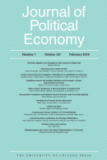
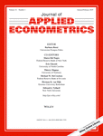


Progress
Replication archives and Data (Code) Availability policies

Slide 18
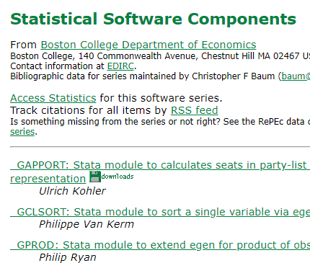

Progress
Replication archives and Data (Code) Availability policies
Shared open source software

Slide 19






Progress
Replication archives and Data (Code) Availability policies
Shared open source software
Better public-use and shared data

Slide 20


Progress
Replication archives and Data (Code) Availability policies
Shared open source software
Better public-use and shared data
Better ways of accessing preprints/ grey literature

Slide 21



Progress
Replication archives and Data (Code) Availability policies
Shared open source software
Better public-use and shared data
Better ways of accessing preprints/ grey literature
Pre-registration of trials, experiments, and analyses

Slide 22
More recently…

Slide 23
Second round (2012-)
Greater enforcement of data (and code) availability
2015, AJ Political Science
2016, Data Editor for ASA Software Section
2016, Statistical review added Science
2017: AEA appoints Data Editor, with mandate to do similar activities (also EJ, Restud)

Slide 24
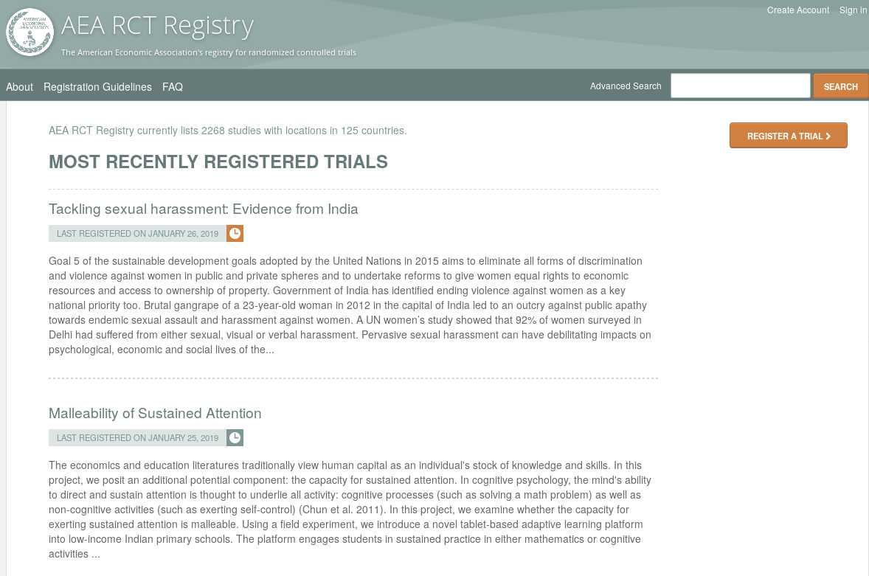
Pre-registration
“That information is especially helpful in research that emphasizes null hypothesis significance testing.
A thorough preregistration promotes transparency and openness and protects researchers from suspicions of p-hacking.”
https://www.psychologicalscience.org/publications/psychological_science/preregistration

Slide 25

Registered Reports
https://cos.io/rr
Chambers (2014)
Nosek & Lakens (2014)
Close cousin: Results-blind review

Slide 26


Preprints in other sciences
bioRxiv (2013)
PsyArXiv (2016)

Slide 27
Paluck (2018) https://osf.io/kvbnh/

Slide 28
Issues

Slide 29
Economics makes wide use of public-use data
Macrodata:
“We use data downloaded from the Bureau of Economic Analysis…”
Microdata:
“… this paper uses data from the Current Population Survey…”

Slide 30
This should be easy!

Slide 31
Problems Making RELIABLE archives
Many datasets
Are imperfectly described
Very few data citations
Are badly documented
Have no (permanent) location defined
Even for data from high-profile organizations!
All of the above

Slide 32
Making USEFUL archives
From analysis of code from 1996 to 2003 (MMH2006):
“Other authors seem to think that the entire world shares the exact same hard drive layout, with ‘‘C:\MYDATA\MYPROJECT\” sprinkled liberally throughout their code. Of course, a would-be replicator has to find and change all these.”
“The author might not realize all the data/subroutine files that his code utilizes, and forget to include said data/subroutine in his replication files.”

Slide 33
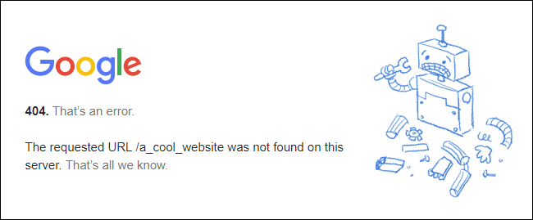
Risk

Slide 34
Still true today…

Slide 35
Let’s try and do better…

Slide 36
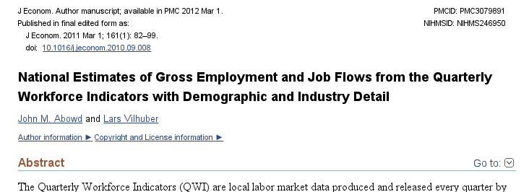
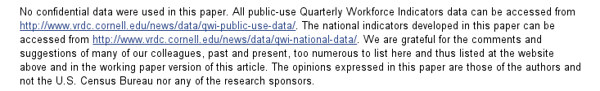
An example

Slide 37
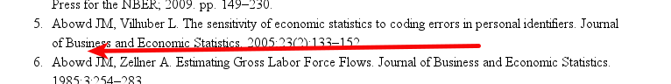
An example: not cited…

Slide 38
Data not attached to article
J of Econometrics Data Policy at the time could not accommodate 50MB file
Data was not attached to paper.
Today’s J of Econometrics policy suggests using third-party repositories
We will get to that later

Slide 39
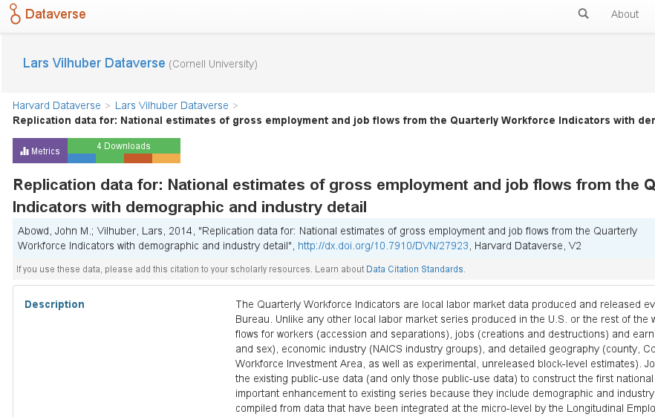
We went back, archived it

Slide 40
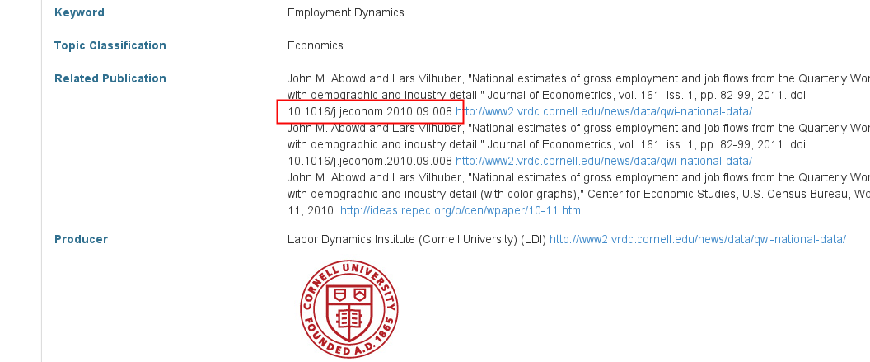
We went back, archived it, linked it back

Slide 41
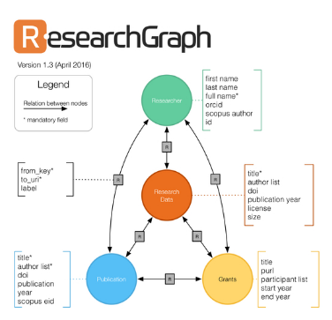


But journal and data infrastructure are incomplete
While Dataverse allows to manually link back…
… the article itself (journal website) reveals none of that
True for most journals, and most data archives
ICPSR (manual linking to articles)
RePEc (no linkage possible)
Infrastructure starting to emerge
If article cites data (DOI!)
If archive and/or journal leverages infrastructure

Slide 42
Still true today…

Slide 43
Issues

Slide 44
Not enough articles are reproducible

Slide 45
Replication continuum
Same data | Same code | Same methods | Same context
08
08
08
Reproducibility
Replicability
Generalizability
Narrow Replication (Pesaran 2003)
Pure Replication (Hamermesh 2007)
Verification (Clemens 2015)
Wide Replication (Pesaran 2003)
Statistical Replication (Hamermesh 2007)
Reproduction/Reanalysis (Clemens 2015)
Wider Replication (Pesaran 2003)
Scientific Replication (Hamermesh 2007)
Reanalysis/Robustness (Clemens 2015)

Slide 46
Results?

Slide 47
Some key statistics
Study | Year | N | Success | Type | Type-R | Type-Data | Percent | Field
Dewald Thursby Anderson | 1986 | 54 | 2 | Complete | Reproducibility | Avail | 4% | Economics
Dewald Thursby Anderson | 1986 | 54 | 7 | Partial | Reproducibility | Avail | 13% | Economics
McCullough McGeary Harrison | 2006 | 186 | 14 | Complete | Reproducibility | All | 8% | Economics
McCullough McGeary Harrison | 2006 | 62 | 14 | Complete | Reproducibility | Avail | 23% | Economics
Nosek et al | 2015 | 100 | 36 | Complete | Replication |  | 36% | Psychology
Camerer et al | 2016 | 18 | 11 | Complete | Replication |  | 61% | Experimental Econ
Chang Li | 2017 | 67 | 22 | Complete | Reproducibility | Avail | 33% | Macroeconomics
Kingi et al | 2018 | 274 | 69 | Complete | Reproducibility | All | 25% | Economics
Kingi et al | 2018 | 162 | 69 | Complete | Reproducibility | Avail | 43% | Economics
Kingi et al | 2018 | 162 | 137 | Partial | Reproducibility | Avail | 85% | Economics
Kingi et al numbers are preliminary. Do not cite or quote.

Slide 48

In a nutshell
40% use restricted-access data
25% use public-use data and are mostly or completely reproducible
25% use public-use data and are only partially reproducible
10% fail to yield useful results
It’s only ½ full!
Hey, it’s not empty!

Slide 49
Issues

Slide 50
Not enough data is “accessible”

Slide 51
Current Data Availability Policies are Broken
If the Data is not open-access, no systematic information is collected (“exemption”)

Slide 52
It is not the access that is “broken”

Slide 53
Illustration
If you used files at the National Archives, would we ask you to “deposit” them?

Slide 54
It is the description of access that is “broken”

Slide 55
Current Data Availability Policies are Broken
If the Data is open-access, no systematic information is collected (not cited, lack of information)

Slide 56
What to do about it?

Slide 57
Evolving Journal and Data Infrastructure

Slide 58
Why do journals like “supplemental ZIP files” and affiliated repositories?
They can ensure longevity/ persistence
They can ensure access
They can ensure availability

Slide 59
What are the characteristics of prominent data archives?
They DO ensure longevity/ persistence
They DO ensure access
They DO ensure availability

Slide 60
Evolving Journal and Data Infrastructure
More self-deposit repositories in the social sciences
Dataverse
Figshare
openICPSR
Zenodo
Qualitative Data Repository (QDR)
Others…

Slide 61
In a nutshell
40% use restricted-access data
25% use public-use data and are mostly or completely reproducible
25% use public-use data and are only partially reproducible
10% fail to yield useful results
It’s only ½ full!
Hey, it’s not empty!

Slide 62
Evolving Journal and Data Infrastructure
More self-deposit repositories in the social sciences
Dataverse
Figshare
openICPSR
Zenodo
Qualitative Data Repository (QDR)
Others…
CASD
IAB
Norway
US Federal Statistical RDC
….

Slide 63
Evolving Journal and Data Infrastructure
Goal: Use any repository!
(subject to conditions)

Slide 64
But: Encourage Best Practices
Deposit and archive early
If you collect data, archive it immediately (possibly privately)
If you finish the manuscript, archive the analysis files (possibly privately)

Slide 65
Evolving Journal and Data Infrastructure
Treat all archives symmetrically!

Slide 66
Verifying Data and Code Deposits
Not every data repository is created equal
Github, Dropbox, etc. are not data or code repositories
Is the institutional repository at the University of Southern Venezuela a reliable repository?
Is the institutional repository at Cornell University a reliable repository?
Is the institutional repository at Harvard University (Dataverse!) a reliable repository?
Are the National Archives a reliable repository?

Slide 67
Verifying Data and Code Deposits
Not every restricted-access repository is created equal
The Second Bank of Third City credit card data is not a data/code repository
Is the School Board of Third City a reliable repository?
Is the JPMC Institute a reliable repository?
Is the US Census Bureau a reliable repository?
Are any restriced-access repositories reliable archives?

Slide 68
Evolving Journal and Data Infrastructure
So: Describe them!
(cite them!)

Slide 69
Data (and Code) Availability Statements
A statement about where data supporting the results reported in a published article can be found
including unique identifiers linking to publicly archived datasets analyzed or generated during the study.
DASs can increase transparency by providing a reason why data cannot be made (immediately) available
need for registration, ethical or legal restrictions, or because of an embargo period

Slide 70
“Unscripted Segway”
Does that mean I cannot use data from Firm ABC?
Does that mean I have to give my data away?

Slide 71
Current efforts at the AEA

Slide 72
Current efforts at the AEA
Provide more transparency
To assist replication efforts
By better linking to paper-related resources
Public-use data
Restricted-access data
Code
Pre-Registration when available

Slide 73
Current efforts at the AEA
Pre-emptively improve code archives
By conducting reproducibility checks when we can
By working with groups that conduct reproducibility checks when we cannot

Slide 74
Current efforts at the AEA
Better archives
Greater transparency of the code and data archives
Better provenance tracking
Leave code where it is when appropriate
Leave data where it is almost always
Display that information

Slide 75
AEA “Data Availability Policy” (2018)
It is the policy of the American Economic Association to publish papers only if the data used in the analysis are clearly and precisely documented and are readily available to any researcher for purposes of replication.
Authors of accepted papers that contain empirical work, simulations, or experimental work must provide, prior to publication, the data, programs, and other details of the computations sufficient to permit replication. These will be posted on the AEA website. The Editor should be notified at the time of submission if the data used in a paper are proprietary or if, for some other reason, the requirements above cannot be met.

Slide 76
AEA “Data Availability Policy” (2018)
It is the policy of the American Economic Association to publish papers only if the data used in the analysis are clearly and precisely documented and are readily available to any researcher for purposes of replication.
Authors of accepted papers that contain empirical work, simulations, or experimental work must provide, prior to publication, the data, programs, and other details of the computations sufficient to permit replication. These will be posted on the AEA website. The Editor should be notified at the time of submission if the data used in a paper are proprietary or if, for some other reason, the requirements above cannot be met.

Slide 77
AEA “Data Availability Policy” (2019)
It is the policy of the American Economic Association to publish papers only if the data used in the analysis are clearly and precisely documented and access to the data and code is clearly and precisely documented and is non-exclusive to the authors.
Authors of accepted papers that contain empirical work, simulations, or experimental work must provide, prior to acceptance, the data, programs, and other details of the computations sufficient to permit replication, as well as information about access to data and programs.

Slide 78
AEA “Data Availability Policy” (2018)
These will be posted on the AEA website. The Editor should be notified at the time of submission if the data used in a paper are proprietary or if, for some other reason, the requirements above cannot be met.
Data and programs should be archived in the AEA Data and Code Repository. Authors will provide access to editors and reviewers, if requested, to both data and programs prior to acceptance. The Editor should be notified at the time of submission if access to the data used in a paper is restricted or limited, or if, for some other reason, the requirements above cannot be met. The AEA Data Editor will assess compliance with this policy, and will verify the accuracy of the information prior to acceptance by the Editor.

Slide 79
Action: Encourage Best Practices
Follow robust coding
Ensure that code reliably produces results (possibly automated)
Before you finish the manuscript, run all analysis code again (if not too onerous)

Slide 80
Action: Pre-Publication Verification
Every paper that receives a “conditional acceptance” is verified
Data citations
Quality of README
Quality of code
Reproducibility of code
Quality of metadata in the repository

Slide 81
Action: Verifying Data and Code Deposits
Check README
Legible? Intelligible? Complete?
Check Code
Where is Table 1? Figure 1? Could this work?
Check Access Rights
Can the author provides us with data?
Does the data access as described work?

Slide 82
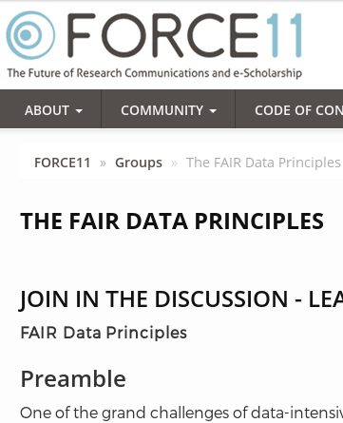
Action: Data citations and metadata
What is FAIR?
Findable,
Accessible,
Interoperable, and
Re-usable

Slide 83
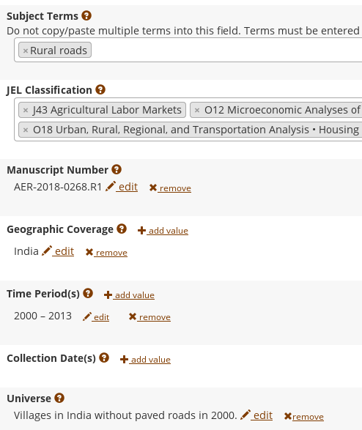
FAIR principles rely on metadata

Slide 84
Replication continuum
Same data | Same code | Same methods | Same context
08
Reproducibility
Narrow Replication (Pesaran 2003)
Pure Replication (Hamermesh 2007)
Verification (Clemens 2015)

Slide 85
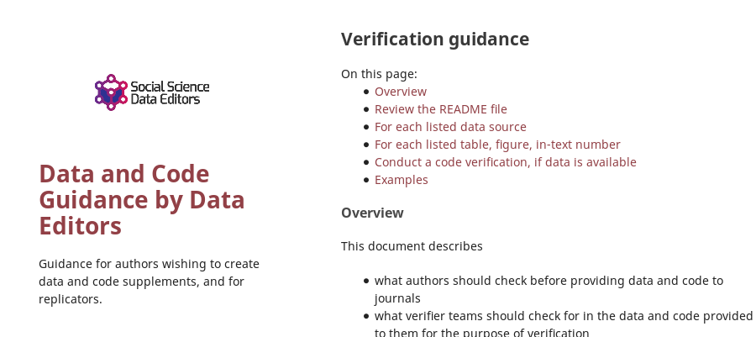

Action: Reproducibility Check

Slide 86
Goal: Improve reproducibility

Slide 87
Moving away from “supplemental data”
Data as a primary object
Title
Permanent location
Citable!
Better data repositories
Move away from ZIP files attached to web pages
Greater clarity about locations

Slide 88
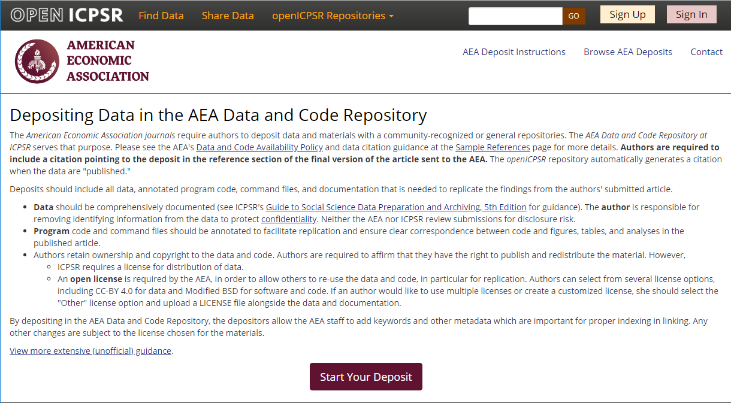
Full-featured repository

Slide 89
Challenges?

Slide 90
Reproducibility is harder than it should be
Often done piecemeal
At different times
By different people
Software versions
Stata 9? 15? 42?
rdrobust 2014? 2016? 2018 bug fix?
Compilers and exotic software

Slide 91
Restricted access data
40% of Econ articles use restricted access data
Costly or time-intensive to acquire access
Access may require physical access in California, Australia, Norway, …
When collecting own data, informed consent and IRB approval must be obtained to share data
If not done at the start, may not be possible later!

Slide 92
Impossible?

Slide 93
Lots of good examples
Open source software has practices that ensure reproducibility, but also describe it
Many papers do an admirable job, and teach the replicator how to proceed
Tools:
Make files and modern replacement
Docker
Rmd files
Maybe Jupyter notebooks (they have some issues)

Slide 94
Lots of good examples (restricted-access data)
IAB FDZ enforces reproducibility through its access procedures
So does the CDER/Statistics Canada
Some European agencies have excellent data documentation
So does (sometimes) Statistics Canada
Access procedures are often quite formal but impartial
US, Canada, France, Germany, etc.

Slide 95
Lots of bad examples too….

Slide 96
Goal: Confidential data
Work with Research Data Centers to facilitate transparency and reproducibility
Training (secure programming guidelines)
Standardize archives within RDCs + transparency
Develop guidelines and internal processes for preservation, reproducibility
Work with researchers to interact with data providers
Work with private sector data providers to clarify procedures, improve openness

Slide 97
Future efforts
AEA, Social Sciences, elsewhere

Slide 98
Better support for researchers
Training in methods (with various centers, institutions, etc.)
For current researchers
For integration into curriculums
Tools to streamline the process
A few technical things (not described here)
Coordinate among journals (no duplicate effort)
Awareness
Consider badges/ certification
Address issues with confidential data

Slide 99
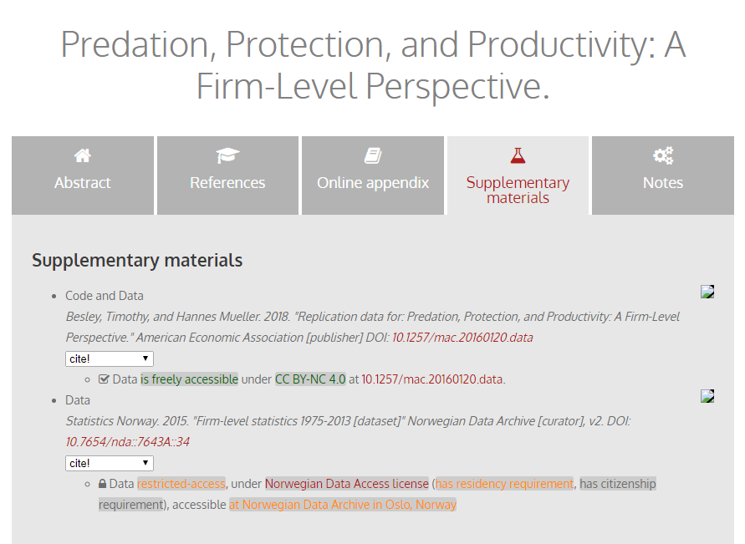
Richer metadata, more transparency

Slide 100
Collaboration

Slide 101
Goal: Transportability
Any standards, tools, methods: must be transportable across journals (no custom solutions)

Slide 102
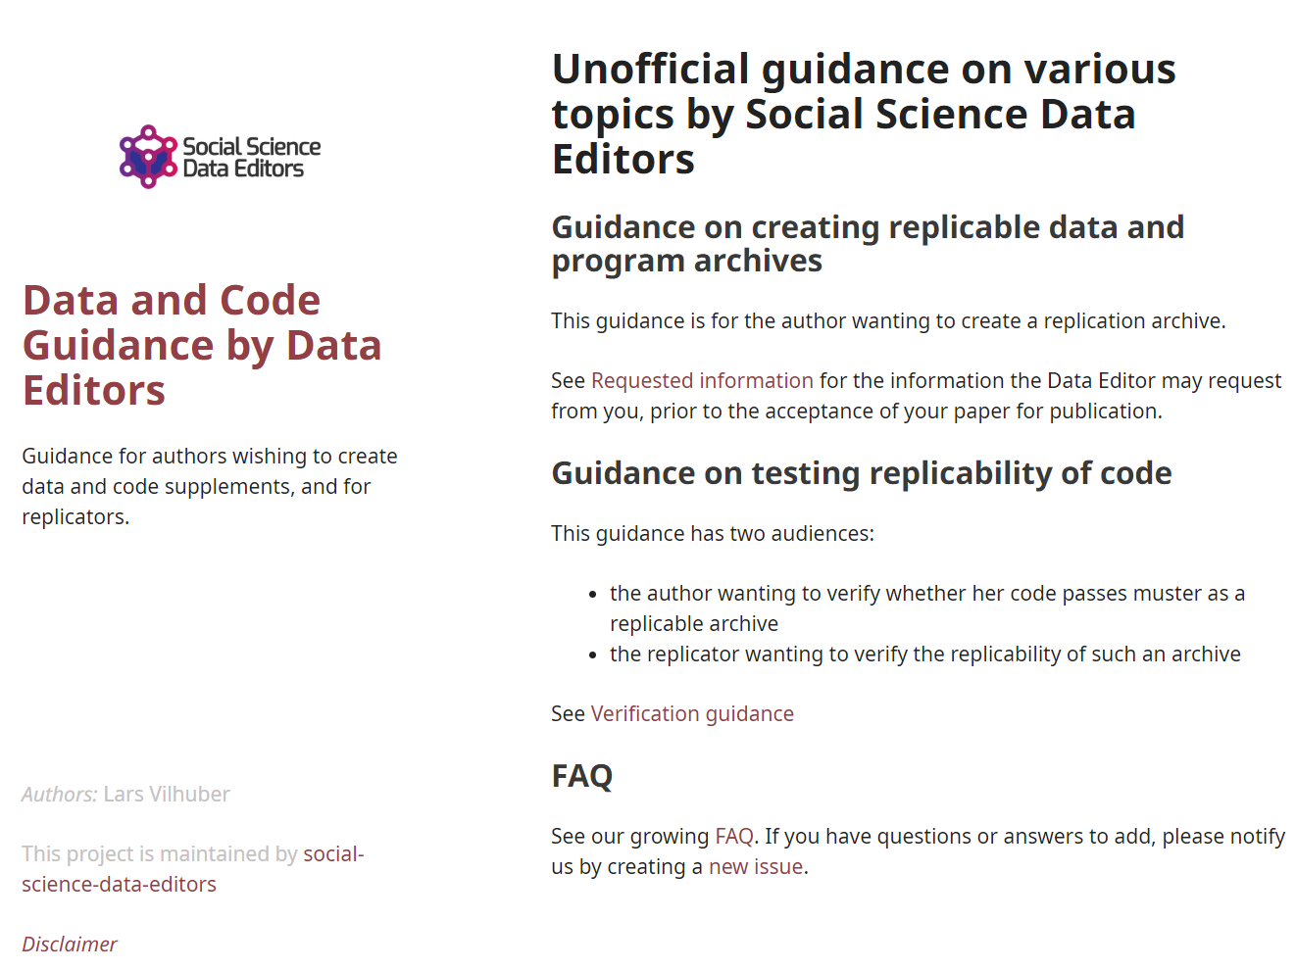
Social science “guild”
https:// social-science -data-editors. github.io/ guidance/

Slide 103
Challenges?

Slide 104
You…

Slide 105
Me…

Slide 106
Change ingrained habits…

Slide 107
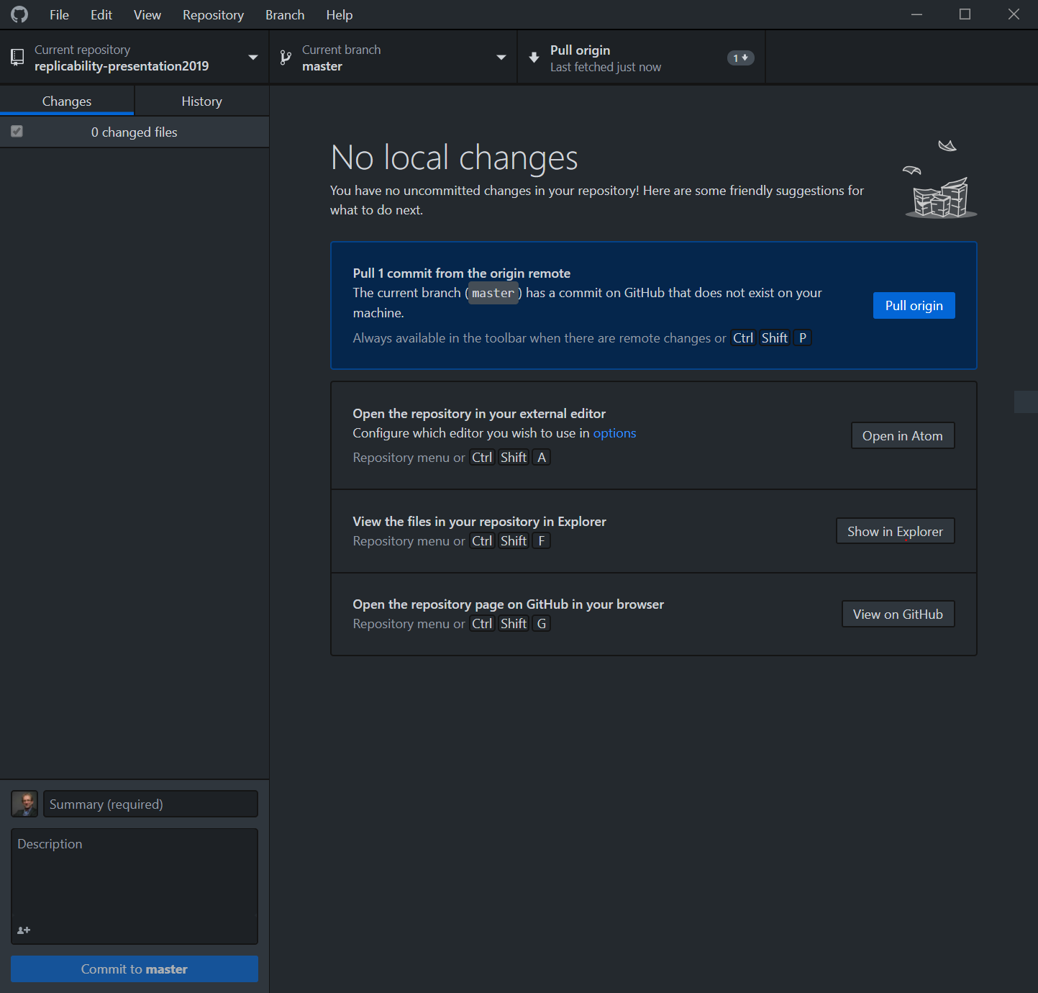

Slide 108
New skills to learn…

Slide 109
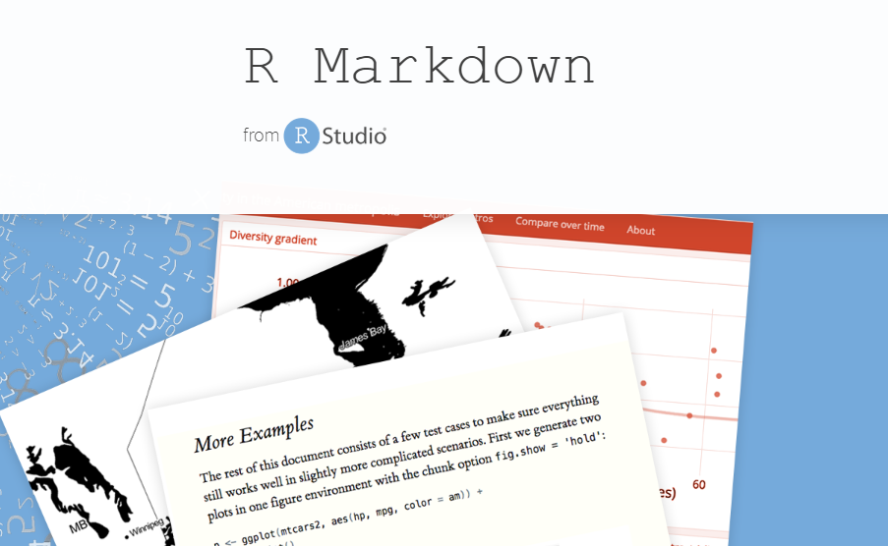
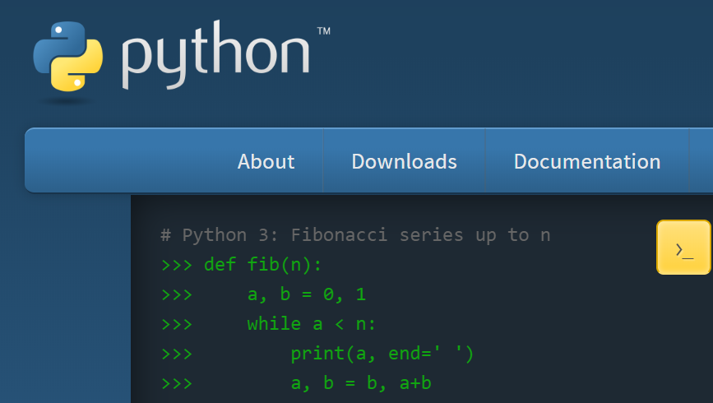

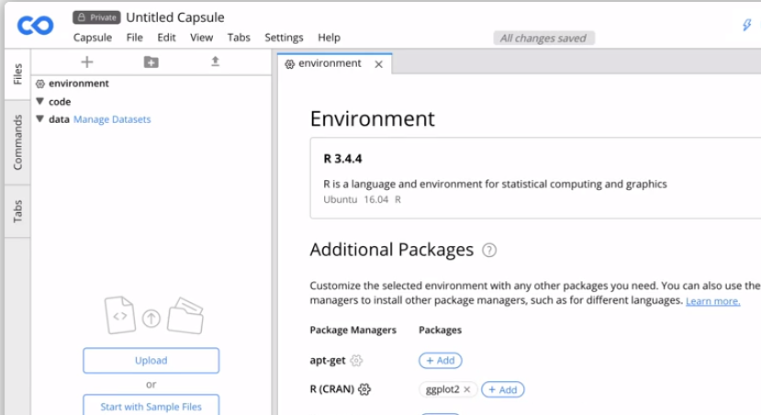



Slide 110
New methods to use …

Slide 111

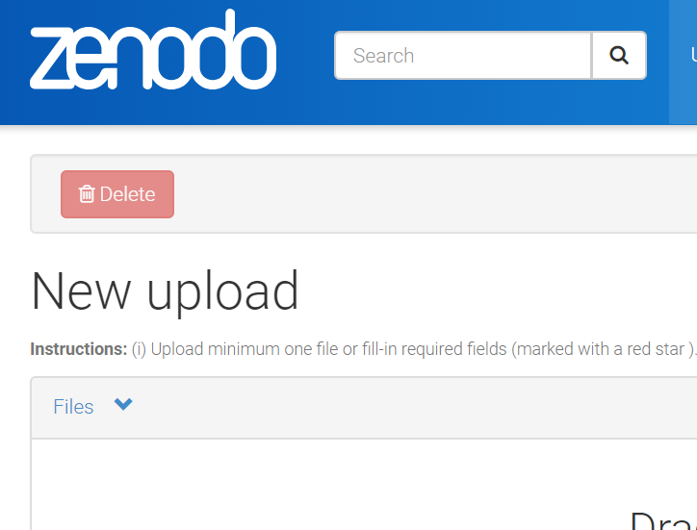
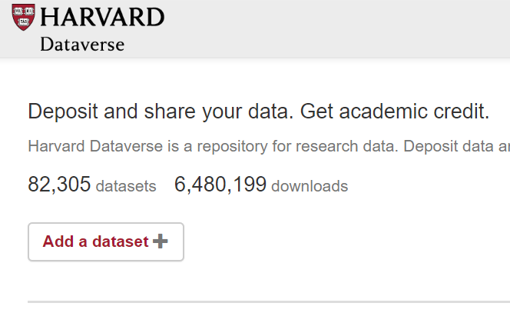
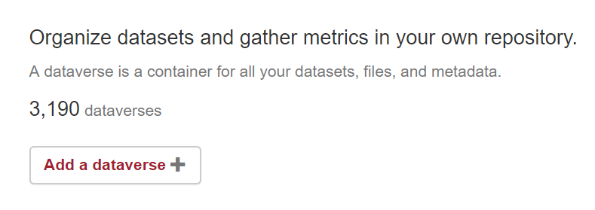

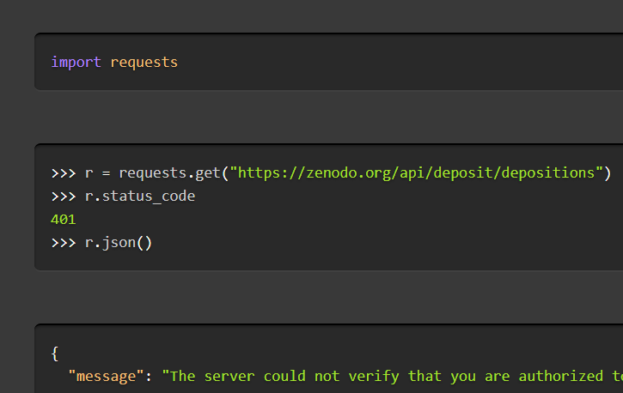

Slide 112
We!
Ingrained habits
New skills to learn
New methods to use

Slide 113
Push for better support…

Slide 114
Researchers: New skills to learn/teach
How to incorporate reproducible practices into your workflow
When to pre-register, and when not to
Document early, and often (better READMEs!)
How, where, and when to archive data and code
How to license your contributions!

Slide 115
Glimpses

Slide 116
Some random notes
Analogy between grant or RDC proposal and pre-registration
Incentives of stats agencies: transparency = credibility
Challenges with ad-hoc access (individuals accessing ministry data, CD in the back pocket/file drawer, unnamable private company)
From pre-acceptance verification to pre-submission verification (university or institute services) and the role of contract programming

Slide 117
Summary

Slide 118
Goals
Greater transparency
Equal treatment of public-use and confidential data
Better computational reproducibility
For public data as well as confidential data
Greater reliance on shared resources
Encourage best practices

Slide 119
Challenges for Surrounding Data
Verifiability
How can others obtain access?
Documentation
How can others learn about the data?
Persistence
How are data and programs preserved?

Slide 120
Thank you!
DOI: 10.5281/zenodo.2573123

Slide 121
Extra slides

Slide 122
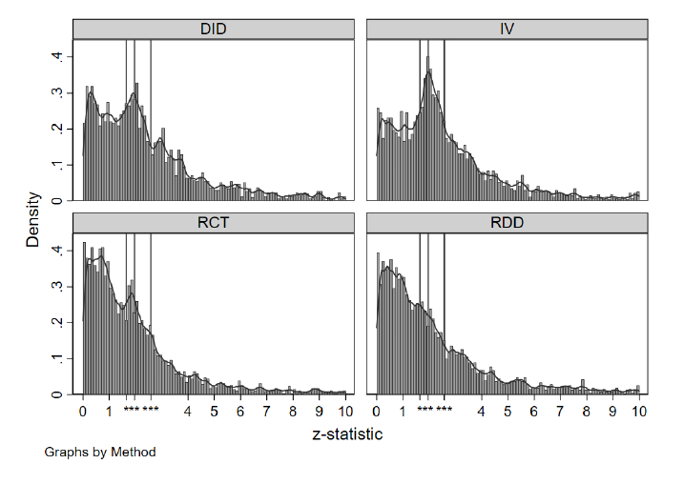
Other challenges remain: Publication bias
Abel Brodeur (2018), https://osf.io/hg9an/

Slide 123
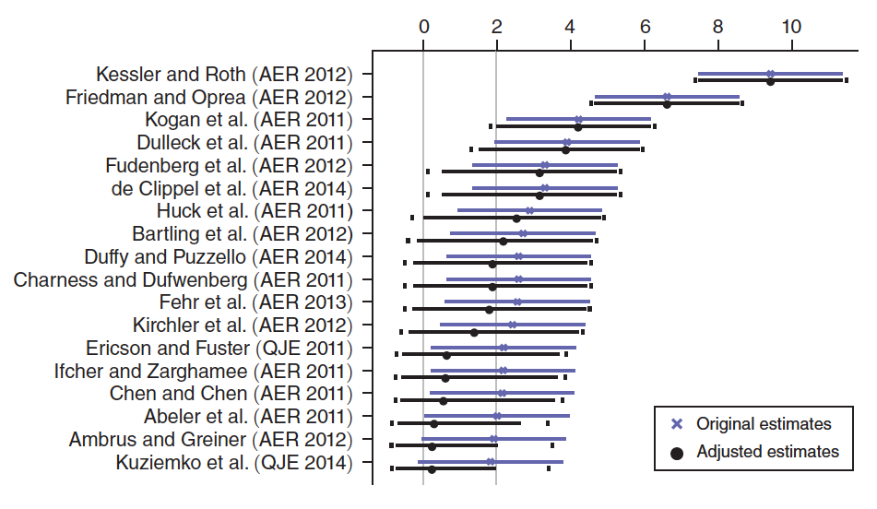
Correcting for publication bias
Andrews & Kasy (2019), https://doi.org/10.1257/aer.20180310

